Slide 1

Heaps
"Teachers open the door, but you must enter by yourself. "
- Chinese Proverb
CLRS, Sections 6.1 – 6.3

Slide 2
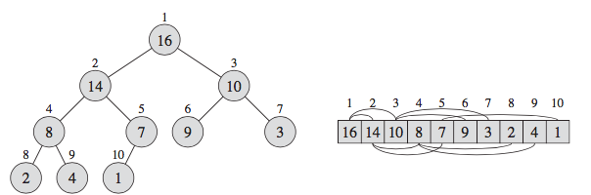
Binary Heaps
A binary heap is a data structure that we can viewed as a mostly complete binary tree.
Not to be confused with the runtime heap.
Portion of memory for dynamically allocated variables.
All levels have maximum number of nodes, except deepest where nodes are filled in from left to right.
Implementation is usually array-based.
root
levels
leaf: node w/o children

Slide 3
Binary Heap
Two kinds of binary heaps:
Max-Heap and Min-Heap
Each maintains the heap order property.
The Max-Heap satisfies the Max-Heap Property:
A[Parent[i]] ≥ A[i]
The Min-Heap satisfies the Min-Heap Property:
A[Parent[i]] ≤ A[i]
Both types are used to implement priority queues.
The Max-Heap is used in the heapsort algorithm.

Slide 4
Example: Min-Heap
12
17
16
19
52
37
25
21
45

Slide 5
Is It a Max-Heap?
91
77
46
69
3
11

Slide 6
Is It a Max-Heap?
91
77
46
69
3
11
No, bottom level not filled in left to right.

Slide 7
Is It a Max-Heap?
52
77
46
69
3
11

Slide 8
Is It a Max-Heap?
52
77
46
69
3
11
No, max value is not at the top.

Slide 9
Is It a Max-Heap?
91
77
46
69
3
11

Slide 10
Is It a Max-Heap?
91
77
46
69
3
11
Yes, it is.

Slide 11
Height of Binary Heap
Height of node is number of edges on longest downward path from node to a leaf.
Not to be confused with depth of node, number of edges between node and root.
Also note, if heap is not complete tree, some nodes on the same of level will not have same height.
Height of heap is height of root.

Slide 12
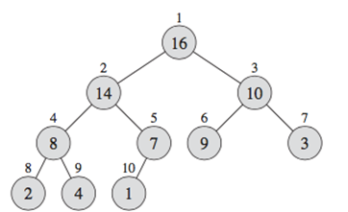
Height of Binary Heap
Height
Depth
3
2
1
0
0
1
2
3

Slide 13
Height of Binary Heap
Height h of heap of n elements is h = Θ(log₂n).
Heap with height h has:
at least 2^{h} elements.
1 + 2 + 2² + … + 2^{h-1} + 1 = 2^{h}
at most 2^{h+1} -1 elements.
1 + 2 + 2² + … + 2^{h} = 2^{h+1} -1

Slide 14
Min-Heap: Insert Operation
Add new element to next open spot at the bottom of the heap.
If new value is less than parent, swap with parent.
Continue swapping up the tree as long as the new value is less than its parent’s value.
Procedure the same for Max-Heaps, except swap if new value is greater than its parent.

Slide 15
Example: Min-Heap Insert
Heap before inserting 15:
12
17
16
19
52
37
25
21
45

Slide 16
Example: Min-Heap Insert
Add 15 as next left-most node.
12
17
16
19
52
37
25
21
45
15

Slide 17
Example: Min-Heap Insert
Because 15 < 52, swap.
12
17
16
19
15
37
25
21
45
52

Slide 18
Example: Min-Heap Insert
Because 15 < 17, swap.
12
15
16
19
17
37
25
21
45
52

Slide 19
Example: Min-Heap Insert
15 > 12, so stop swapping.
12
15
16
19
17
37
25
21
45
52

Slide 20
Min-Heap: Extract Operation
Removes minimum value in the heap.
Store value at the root (min value) for return.
Replace value at root with last value in the heap; remove that last node.
If new root is larger than its children, swap that value with its smaller child.
Continue swapping this value down the heap, until neither child is smaller than it is.
Procedure the same for Max-Heap, except replace value with larger of its two children.

Slide 21
Example: Min-Heap Extract
Original heap:
12
15
16
17
23
37
25
21
45
35

Slide 22
Example: Min-Heap Extract
Replace 12 with 35, remove last node.
35
15
16
17
23
37
25
21
45

Slide 23
Example: Min-Heap Extract
Because 35 > 15 and 16, swap with 15 (smaller).
15
35
16
17
23
37
25
21
45

Slide 24
Example: Min-Heap Extract
Because 35 > 17 and 23, swap 17.
15
17
16
35
23
37
25
21
45

Slide 25
Example: Min-Heap Extract
Because 35 > 21, swap.
15
17
16
21
23
37
25
35
45

Slide 26
Example: Min-Heap Extract
35 now at leaf, stop.
15
17
16
21
23
37
25
35
45

Slide 27
Internal Storage
Interestingly, heaps are often implemented with an array instead of nodes.
12
For element at position i:
parent index: i / 2
left child index: i * 2
right child index: i * 2 + 1
17
16
19
52
37
25
21
45
1 | 2 | 3 | 4 | 5 | 6 | 7 | 8 | 9 | 10 | 11 | 12 | 13 | 14 | 15 | 16
12 | 17 | 16 | 19 | 52 | 37 | 25 | 21 | 45 | - | - | - | - | - | - | -

Slide 28
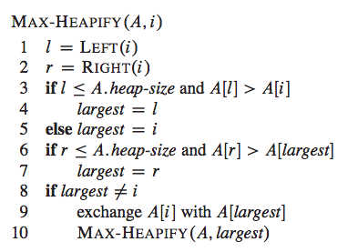
Max-Heap Algorithms
MAX-HEAPIFY(A, i)
Recursive procedure for maintaining Max-Heap property.
Assume binary trees rooted at Left(i) and Right(i) are max-heaps, but A[i] violates the Max-Heap property.

Slide 29
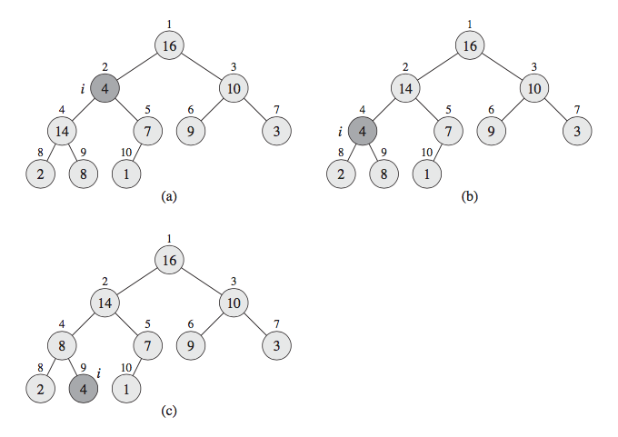
Example: Maintaining Max-Heap Property
MAX-HEAPIFY(A, 2)
l = 2 * 2
r = 2 * 2 + 1
A[4] > A[2]
largest = 4
A[9] < A[4]
no change
4 ≠ 2
exchange A[2], A[4]
Max-Heapify(A, 4)
1 | 2 | 3 | 4 | 5 | 6 | 7 | 8 | 9 | 10 | 11 | 12 | 13 | 14 | 15 | 16
16 | 4 | 10 | 14 | 7 | 9 | 3 | 2 | 8 | 1 | - | - | - | - | - | -
1 | 2 | 3 | 4 | 5 | 6 | 7 | 8 | 9 | 10 | 11 | 12 | 13 | 14 | 15 | 16
16 | 14 | 10 | 4 | 7 | 9 | 3 | 2 | 8 | 1 | - | - | - | - | - | -

Slide 30
Example: Maintaining Max-Heap Property
MAX-HEAPIFY(A, 4)
l = 4 * 2
r = 4 * 2 + 1
A[4] > A[8]
largest = 4
A[9] > A[4]
largest = 9
9 ≠ 4
exchange A[4], A[9]
Max-Heapify(A, 9)
1 | 2 | 3 | 4 | 5 | 6 | 7 | 8 | 9 | 10 | 11 | 12 | 13 | 14 | 15 | 16
16 | 14 | 10 | 4 | 7 | 9 | 3 | 2 | 8 | 1 | - | - | - | - | - | -
1 | 2 | 3 | 4 | 5 | 6 | 7 | 8 | 9 | 10 | 11 | 12 | 13 | 14 | 15 | 16
16 | 14 | 10 | 8 | 7 | 9 | 3 | 2 | 4 | 1 | - | - | - | - | - | -

Slide 31
Example: Maintaining Max-Heap Property
MAX-HEAPIFY(A, 9)
l = 9 * 2
r = 9 * 2 + 1
18 > 10 (A.heap-size)
largest = 9
19 > 10
no change
9 = 9
return
1 | 2 | 3 | 4 | 5 | 6 | 7 | 8 | 9 | 10 | 11 | 12 | 13 | 14 | 15 | 16
16 | 14 | 10 | 8 | 7 | 9 | 3 | 2 | 4 | 1 | - | - | - | - | - | -
1 | 2 | 3 | 4 | 5 | 6 | 7 | 8 | 9 | 10 | 11 | 12 | 13 | 14 | 15 | 16
16 | 14 | 10 | 8 | 7 | 9 | 3 | 2 | 4 | 1 | - | - | - | - | - | -

Slide 32
Runtime Max-Heapify
Runtime based on number of recursive calls.
In the worst case, start at root and have to move value to a leaf.
At most, height of heap h calls.
So Max-Heapify(A, i) = O(h)
but h = log₂(n).
Therefore,
Max-Heapify(A, i) = O(log₂(n)).

Slide 33
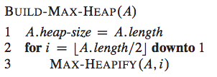
Building a Max-Heap
The leaves are the nodes indexed by:
We can convert an array A into a Max-Heap by using the following procedure.

Slide 34
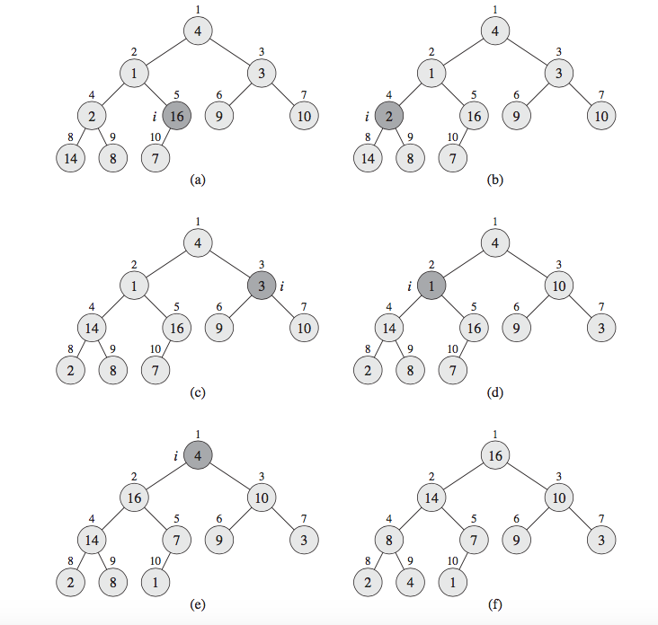
Example: Building a Max-Heap
i = n / 2 = 5
i = 5 – 1 = 4
MAX-HEAPIFY(A, 5)
MAX-HEAPIFY(A, 4)
No change
Swap 2 and 14
1 | 2 | 3 | 4 | 5 | 6 | 7 | 8 | 9 | 10 | 11 | 12 | 13 | 14 | 15 | 16
4 | 1 | 3 | 14 | 16 | 9 | 10 | 2 | 8 | 7 | - | - | - | - | - | -

Slide 35
Example: Building a Max-Heap
i = 4 – 1 = 3
i = 3 – 1 = 2
MAX-HEAPIFY(A, 3)
MAX-HEAPIFY(A, 2)
Swap 1 and 16
Swap 1 and 7
Swap 3 and 10
1 | 2 | 3 | 4 | 5 | 6 | 7 | 8 | 9 | 10 | 11 | 12 | 13 | 14 | 15 | 16
4 | 16 | 10 | 14 | 7 | 9 | 3 | 2 | 8 | 1 | - | - | - | - | - | -

Slide 36
Example: Building a Max-Heap
i = 2 – 1 = 1
MAX-HEAPIFY(A, 1)
Done
Swap 4 and 16
Swap 4 and 14
Swap 4 and 8
1 | 2 | 3 | 4 | 5 | 6 | 7 | 8 | 9 | 10 | 11 | 12 | 13 | 14 | 15 | 16
16 | 14 | 10 | 8 | 7 | 9 | 3 | 2 | 4 | 1 | - | - | - | - | - | -

Slide 37
Runtime Build-Max-Heap
A simple upper bound on the running time of Build-Max-Heap is O(n*log₂n).
However, we can prove that an asymptotically tighter bound is O(n).

Slide 38


Build Max-Heap Running Time
An n-element heap has:
height
at most nodes at height h
runtime for Max-Heapify = O(h).
Then, the running time is:
T(n) =
runtime for Max-Heapify
over each level of heap
max number of nodes at each level

Slide 39
Build-Max-Heap Running Time
However, we can simplify this expression. Using summation formula (A.8) , we get
Therefore, we can build a heap from an unordered array in O(n) time.
T(n) =
= 2
= 2*O(n) = O(n)

